Slide 1
Class One Getting Started
Kim Johnson

Slide 2
Lecture Outline
Class Introductions
Review course syllabus
Getting started with data analysis

Slide 3
Getting help with R and R errors
My advice: Google
Coders are a tribe of people who help each other
This is a standard problem solving (and learning) approach
Consult R help by typing help(topic) in the console or by searching for the topic in the help window!

Slide 4
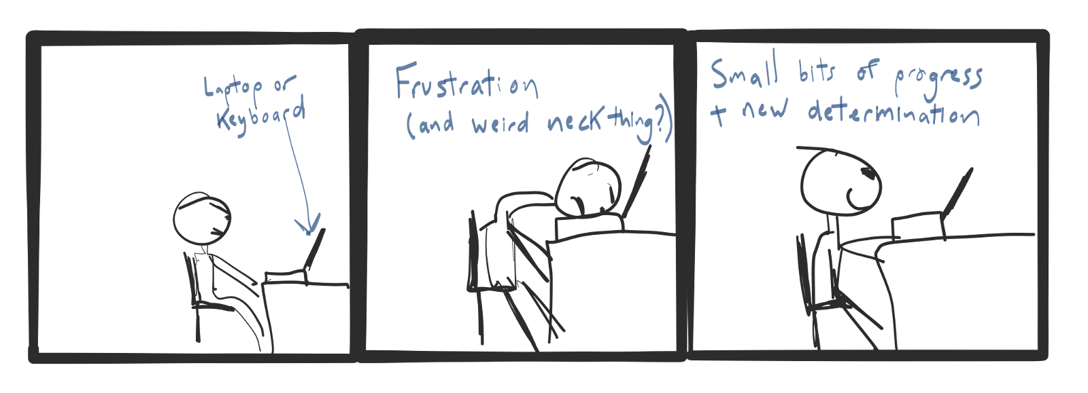

Slide 5
Learning objectives
Understand typical project workflow
Be able to import data
Be able to characterize the dataset
Clean up variables
Derive one variable
Calculate simple statistics

Slide 6
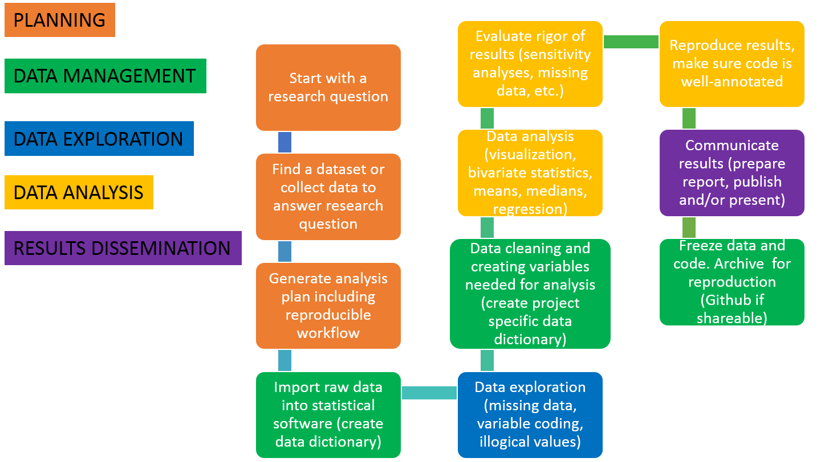
Example project workflow

Slide 7
A refresher on basic stats tasks in R
Installing packages and libraries
Reading in files of different types
Characterizing the dataset
Renaming, cleaning, and creating variables
Simple stats (mean, median, etc.)

Slide 8
Open R studio and let’s install some packages and libraries

Slide 9
Let’s read in some different file types
Data are stored on Github when possible and can be imported directly from Github
Github class website: https://github.com/kijohnson/ADA_Spring_2020
NOTE about copying links to datsets housed on Github: On Github click on the file you want to import and if it is readable as is (.csv, .txt), copy and paste the link into your R code for reading the file. If not readable as is (e.g. .sav, .xpt, .dta), in the gray ‘view Raw box’, right click and select ‘open link in new window’ and copy and paste the link address, which should include the following text in the first part: https://raw.githubusercontent.com…

Slide 10
Read in CSV and Stata files
starbucks_csv <- read.csv( "https://raw.githubusercontent.com/kijohnson/ADA_Spring_2020/master/Class%201/starbucks_datasets/starbucks_csv.csv" )#read in csv file starbucks_stata <- read_dta( "https://github.com/kijohnson/ADA_Spring_2020/blob/master/Class%201/starbucks_datasets/starbucks_stata.dta?raw=true" )#read in stata file

Slide 11
Read in tab deliminated file
starbucks_tab <- read.delim( "https://raw.githubusercontent.com/kijohnson/ADA_Spring_2020/master/Class%201/starbucks_datasets/starbucks_tab.txt" )#read in tab file

Slide 12
Read in xpt and spss files
starbucks_xpt <- read_xpt( "https://github.com/kijohnson/ADA_Spring_2020/blob/master/Class%201/starbucks_datasets/starbuck_xpt.xpt?raw=true" )#read in SAS XPT file. Interesting note about this format: #"The SAS transport format is an open format, as is required for submission of the data to the FDA." #(from help page when *??read_xpt* is typed into the console) starbucks_spss <- read.spss( "https://github.com/kijohnson/ADA_Spring_2020/blob/master/Class%201/starbucks_datasets/starbucks_spss.sav?raw=true", to.data.frame=TRUE )#read in SPSS file

Slide 13
Characterize the datasets (no. of obs, variables, basic summary stats, missing data)
dim(starbucks_xpt) #gives number of rows and columns of dataset options(digits=2) #two decimal places in stat.desc table stat.desc(starbucks_xpt) #creates nice looking table of summary stats for each variable

Slide 14
Renaming variables
Point to remember about renaming: always try to use decriptive names rather than x, y, a, b, c.
names(starbucks_xpt)<-c("drink", "category", "calories", "fat (grams)", "carb (grams)", "fiber (grams)", "protein (grams)") #renames variables in order of appearance stat.desc(starbucks_xpt) #creates nice looking table of summary stats for each variable

Slide 15
Clean up calories variable/convert to numeric/find mean and median
class(starbucks_xpt$calories) #check class of calories starbucks_xpt$calories<-as.numeric(as.character(starbucks_xpt$calories)) #convert calories variable to numeric so math can be done class(starbucks_xpt$calories) #check to make sure calories_n is numeric stat.desc(starbucks_xpt) #get summary stats #round to 1 decimal place options(scipen=999) #disable scientific notation options(digits=1) #1 digits stat.desc(starbucks_xpt) #get summary stats

Slide 16
Find mean, median, sd, variance, and quantile
mean(starbucks_xpt$calories, na.rm=TRUE) #get mean median(starbucks_xpt$calories, na.rm=TRUE) #get median sd(starbucks_xpt$calories, na.rm=TRUE) #get sd var(starbucks_xpt$calories, na.rm=TRUE) #get variance quantile(starbucks_xpt$calories, na.rm=TRUE) #get quantile

Slide 17
Categorize calories as binary above and at or below the median, label level values
starbucks_xpt$calories_med[starbucks_xpt$calories > 140] <- 1 #above median starbucks_xpt$calories_med[starbucks_xpt$calories <= 140] <- 0 #at or below median class(starbucks_xpt$calories_med) #check the type of variable starbucks_xpt$calories_med.f<-factor(starbucks_xpt$calories_med,labels = c("Below the median", "Above the median")) #change to factor variable and label levels table(starbucks_xpt$calories_med.f) #determine how many observations are in each level

Slide 18
Find mean number of calories for ‘Starbucks Espresso Beverages’
espresso<-starbucks_xpt[which(starbucks_xpt$category=='Starbucks Espresso Beverages'),] #subset espresso data table(espresso$category) #check that subsetting worked by checking number of espresso drinks in parent dataframe mean(espresso$calories, na.rm=TRUE) #calculate mean number of calories in espresso drinks, removing 'NAs' summary(espresso$calories) #another way to see the mean number of calories in espresso drinks stat.desc(espresso) #another way to see the mean number of calories in espresso drinks

Slide 19
Class activity and HW2
Review of Class 1 survey results (google doc output)
Go to Canvas or Github to download and open HW2
Follow the instructions on the HW2 pdf and let’s start exploring the class1survey data!

